Slide 1



The Histogram-Difference Method (HDM):
A simple, topographical method for discriminating neutron/gamma pulses
Robert M. French (LEAD-CNRS UMR 5022)
Mathieu Thévenin (CEA)
Matthieu Hamel (CEA)
Eva Montbarbon (CEA)
French, R. M., Thévenin, M., Hamel, M. & Montbarbon, E. (2017). A Histogram-Difference Method (HDM) for Neutron/Gamma Discrimination Using Liquid and Plastic Scintillators. IEEE Transactions on Nuclear Science (in press).
Patent filed: FR1753811
ANIMMA 2017, Liège, June 19-23, 2017

Slide 2
The Problem
Pulses are acquired by liquid or plastic scintillators designed to be used in Radiation Portal Monitors.
UNLABELED PULSES (neutron OR γ)
Are there neutrons in the UNLABELED PULSES ?
If so, what percentage?

Slide 3
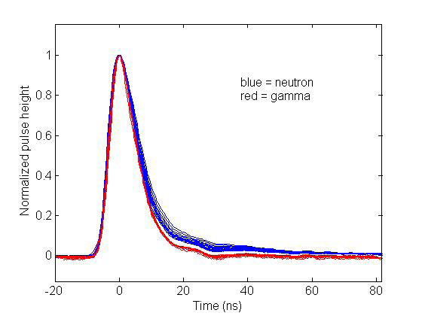
Normalized neutron and gamma pulses are supposed to look like this.
Flaska & Pozzi (2006)

Slide 4
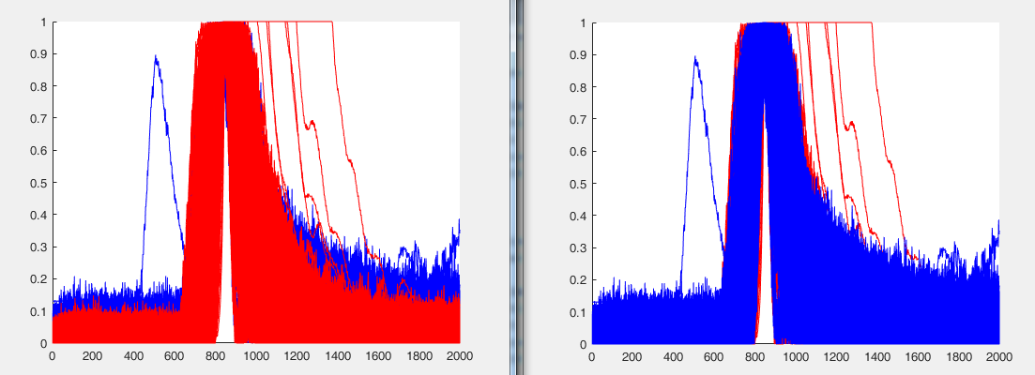
But in reality, they look like this!
Neutrons + gamma pulses = blue
True gamma pulses = red

Slide 5
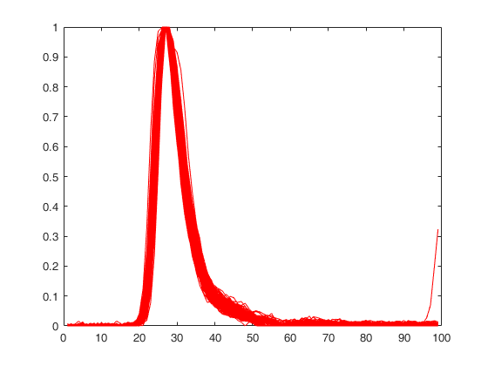
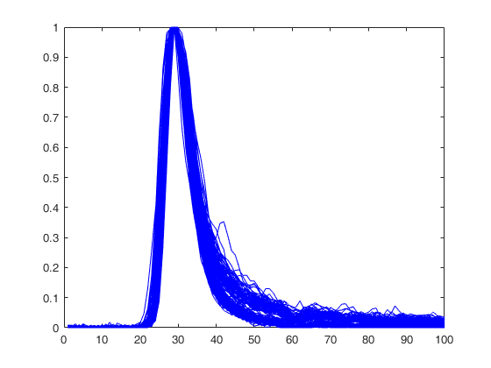
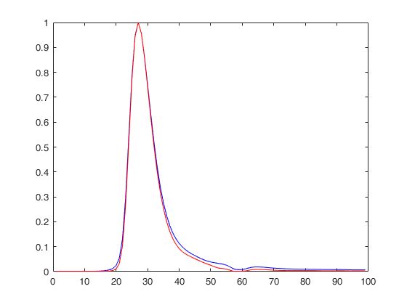
After amplitude normalization and peak alignment
γ-only
n+γ
The average γ-only pulse (red) and the average n+γ pulse (blue).

Slide 6
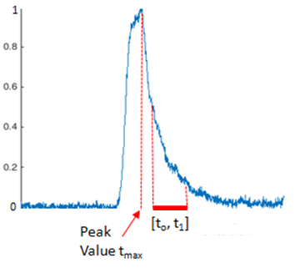
Q-value representation: Each pulse is represented as a pair of real values: (Q_{total} , Q_{tail})

Slide 7
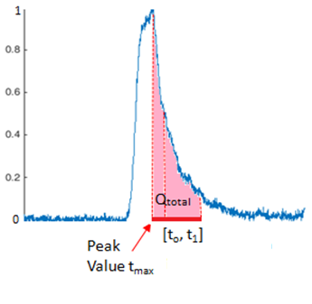
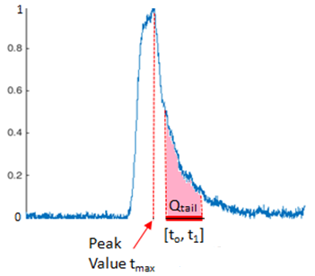
Q-value representation: Each pulse is represented as a pair of real values: (Q_{total} , Q_{tail})
Q_{total}
Q_{tail}

Slide 8
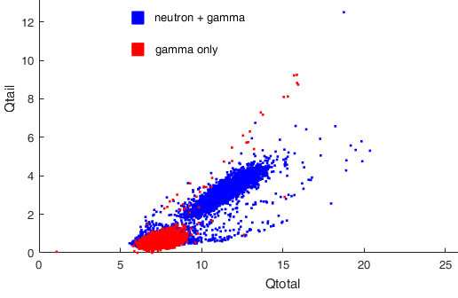
Traditionally, we create a scatterplot from these values: Q_{total} (x-axis) vs Q_{tail} (y-axis).

Slide 9
HDM adds topography (i.e., includes the number of pulses) to produce histograms

Slide 10
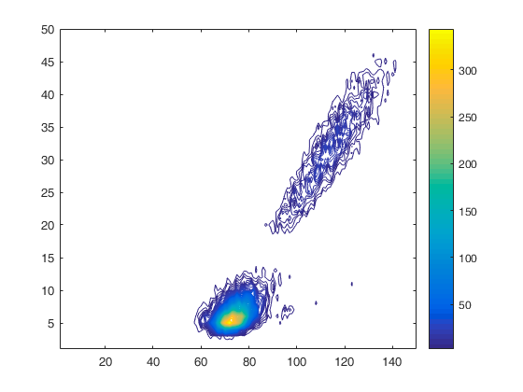
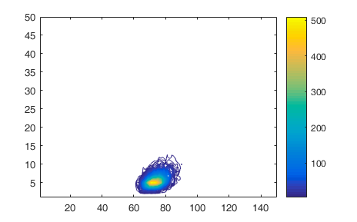
HDM adds topography (i.e., includes the number of pulses) to produce histograms
n+γ
γ-only

Slide 11
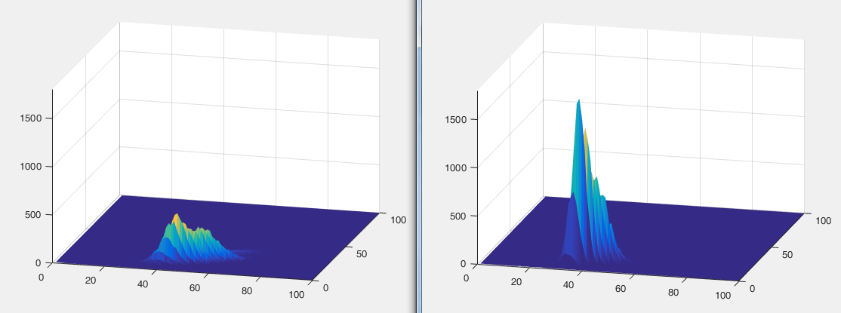
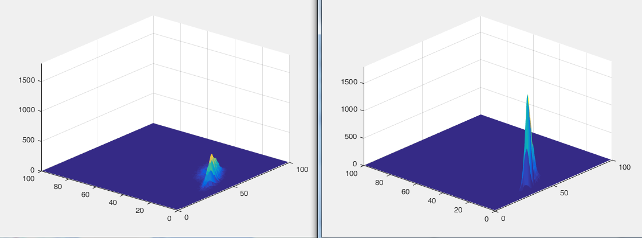
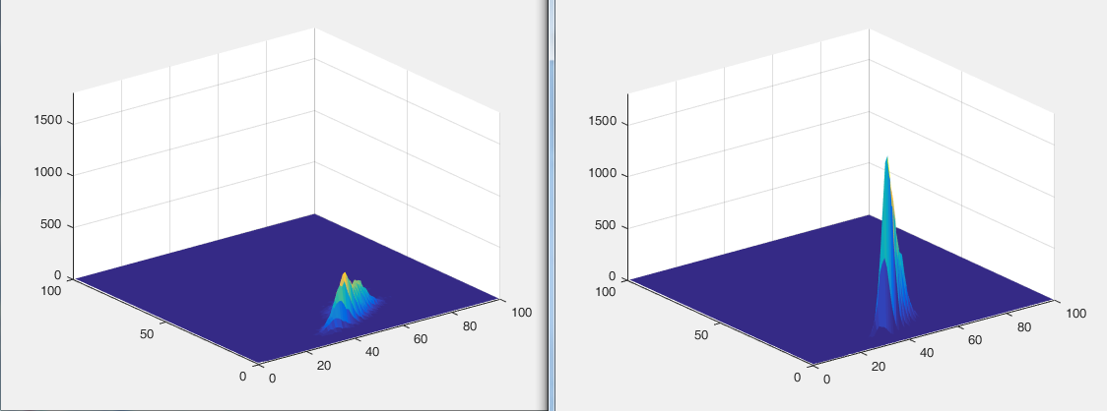
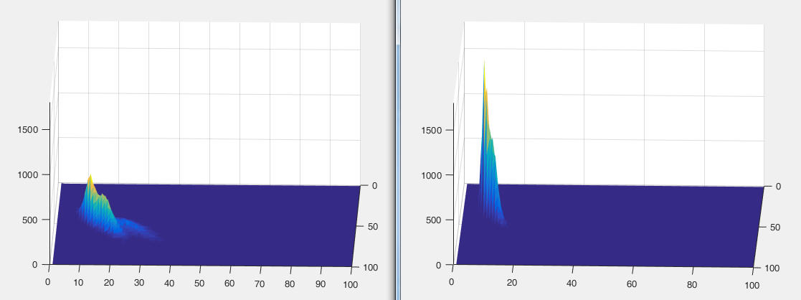
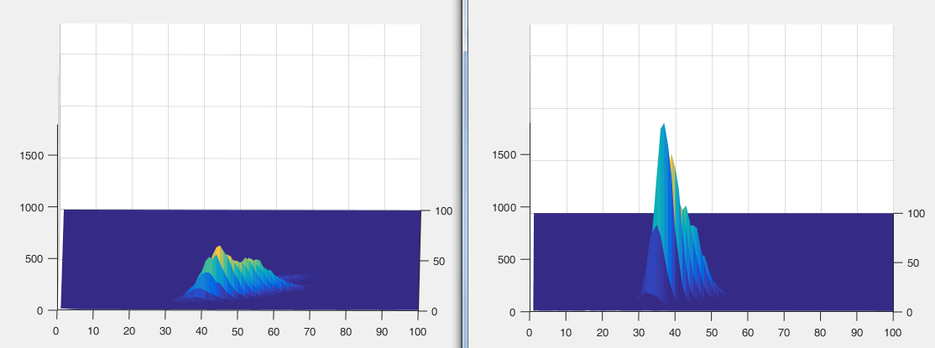
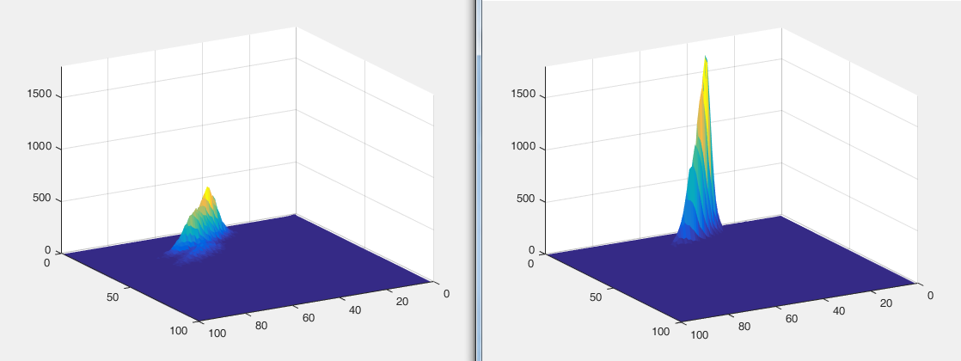
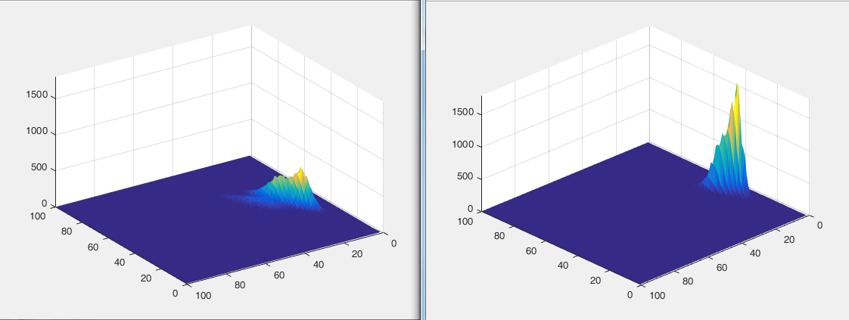
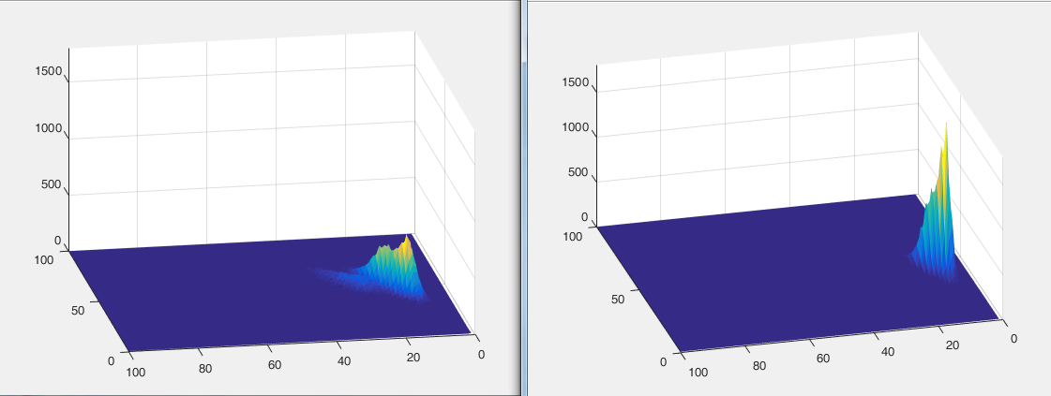
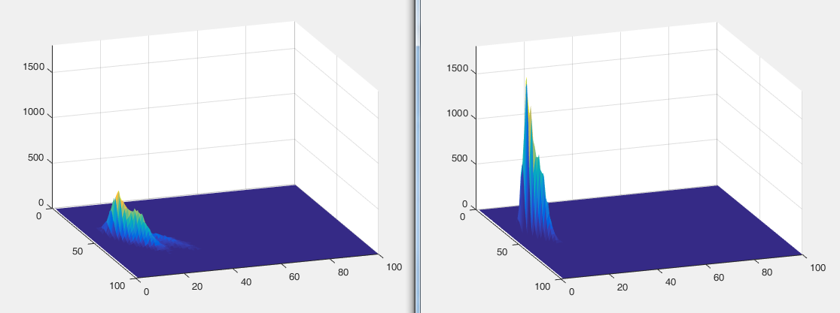
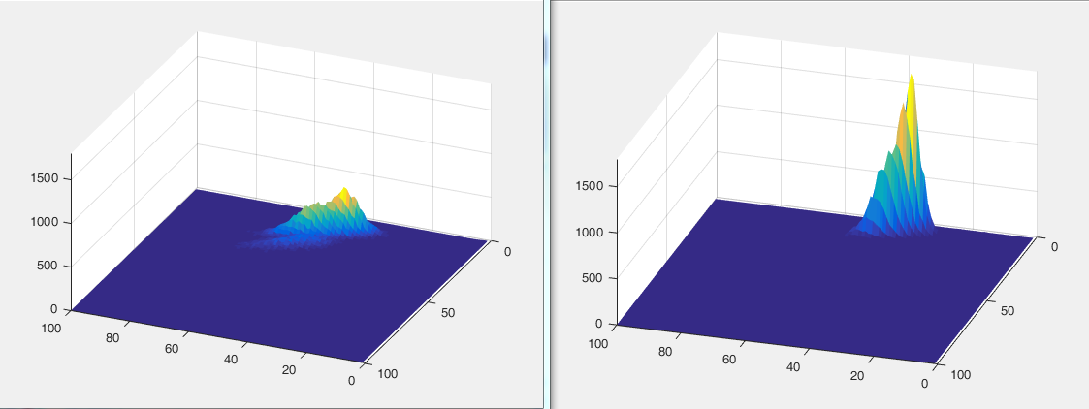
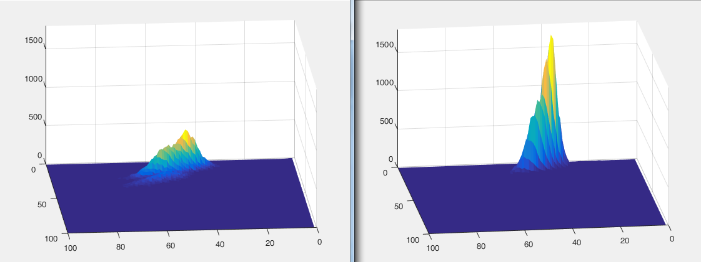
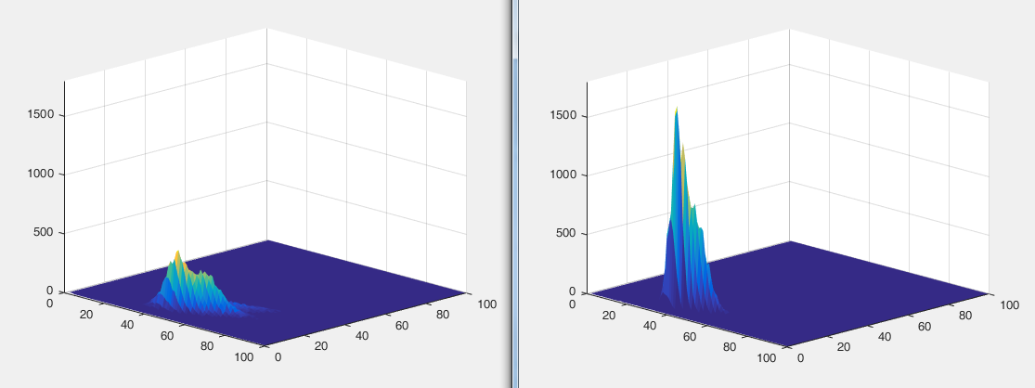
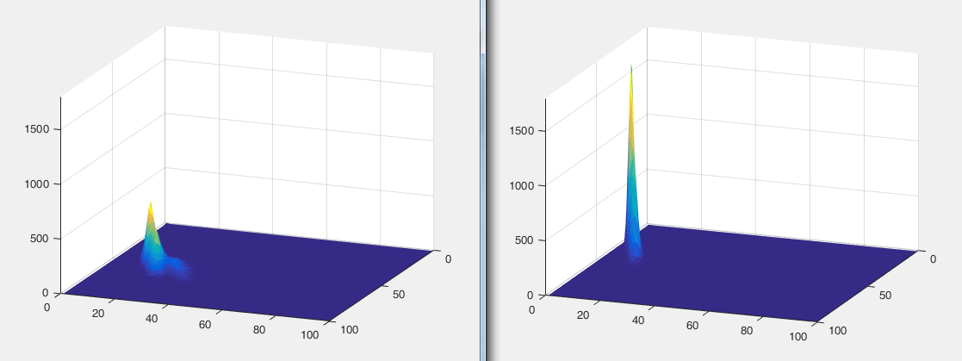
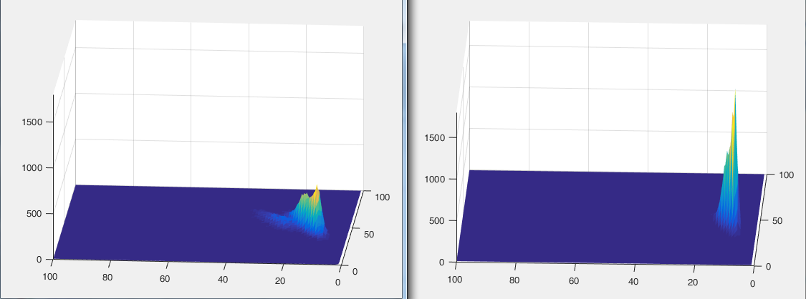
n+γ histogram
(16,000 pulses)
γ-only histogram
(16,000 pulses)
One axis is Q_{total} and the other is Q_{tail}
The height represents the number of (Q_{total} , Q_{tail} ) pairs in each square of a 150x300 grid.

Slide 12
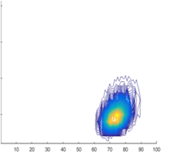
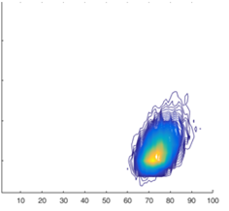
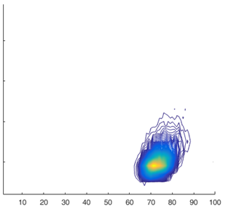
A key assumption of HDM
The histogram for any set of N γ-only pulses, regardless of their source, is essentially the same.
Cs-137
Na-22
Co-60
Offline, we combine pulses from the 3 sources
and create a Reference Set of N γ-only pulses.

Slide 13
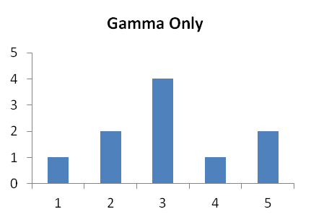
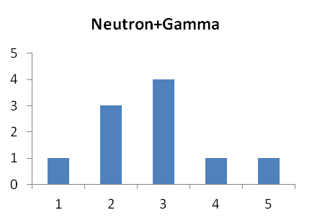
A toy example of how HDM works
Total of ten pulses. Each pulse is represented by an integer between 1 and 5.
Three key assumptions
All γ-only histograms with 10 pulses will look exactly like the γ-only histogram on the left. This is the Reference γ-only Histogram.
There are exactly the same number of pulses (10) in the γ-only histogram and the n+γ histogram.
Any difference between the γ-only histogram and the n+γ histogram
must be due to neutrons.

Slide 14
Comparing a Gamma-only spectrum and a Neutron+Gamma spectrum
Since there are exactly 10 pulses in each histogram,
we see that one γ pulse with a representation of « 5 » in the γ-only spectrum
is replaced by
one neutron pulse with a representation of « 2 » in the n+γ spectrum.
Remember:
Since all 10-pulse γ-only histograms are strictly identical,
any difference between the γ-only histogram and the n+ γ histogram
must be due to neutrons.

Slide 15
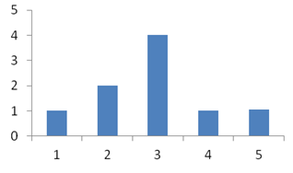
A toy example of HDM (a total of 10 pulses)
n+γ histogram
γ-only histogram
We conclude that there is (at least) one neutron in the Neutron+Gamma sample.
The n+γ sample has at least 10% neutrons.

Slide 16
Consider a slice through the real histogram landscape
No. of pulses
γ histogram
n+γ histogram
If the new n+γ sample is the same size as the γ-only sample, and contains only gamma pulses, its histogram will closely match the γ-only histogram.

Slide 17
Consider a slice through the real histogram landscape
No. of pulses
γ histogram
n+γ histogram
However, any significant divergence from the γ-only histogram will be caused by neutrons. Recall that there must be the same number of n+γ pulses as γ-only pulses.

Slide 18
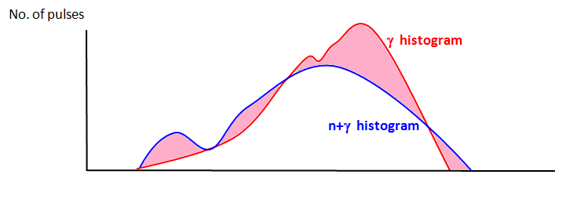
Consider a slice through this landscape
Significant divergence from the γ-only histogram will be caused by neutrons.
This divergence allows us to:
Conclude that neutrons are present in the n+γ sample and
Estimate a lower bound for the % of neutrons in the sample.

Slide 19
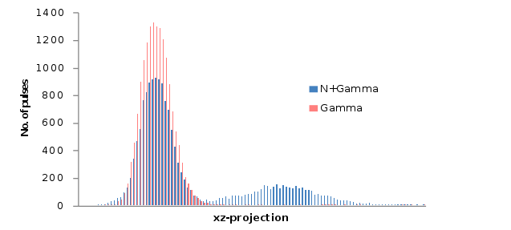
A “summed projection” onto the yz-plane of the 3D Q-value histogram of 16,000 γ-only pulses (red) and 16,000 n+γ pulses (blue).
This graph illustrates the key principle of the HDM: the differences with respect to the γ-only reference histogram (red) are due to the presence of neutrons.
The difference in the two summed projections allows us to determine the approximate minimum percentage of neutrons in the n+γ set.

Slide 20
Results
Scintillator | Neutron estimate (%) Cf-252
BC-501-A | 29.9
E32 | 26
EJ-299-33 | 26.3
EJ-200 | 23.2
Using other techniques, this value has been reported elsewhere in the literature to be between 25% and 30%.
For all scintillators the bias is approximately 4%

Slide 21
HDM is representation-independent
HDM does not require a single type of pulse representation.
Other possible pulse representations: ToT, Zero-Crossing time, Rising Time, etc.
We tested HDM using an entirely different representation from Q-values, D-values which represent each pulse as its RMS distance to the average of all pulses in the γ-only Reference Set.

Slide 22
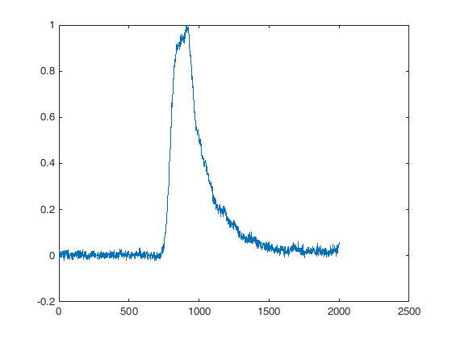
For all pulses in the γ-only reference set, S_{γ}, and in the test set, S_{n+γ}, we only consider their values between t₀ = 20 and t₁=150.
1
20
150
Normalize
Truncate
130-value vector

Slide 23
We then calculate the average of these 130-value vectors for all pulses in the γ-only reference set, S_{γ}. This vector is the centroid pulse, C_{γ} for S_{γ}.
For all pulses in S_{γ} and in S_{n+γ} we calculate the Euclidean distance to C_{γ}. We call these D-values. For each pulse, its distance to C_{γ} constitutes its D-value representation.
We bin these D-values to create a γ-only histogram and an n+γ histogram.
The difference between these histograms gives a lower bound on the % of neutrons in the n+γ sample.

Slide 24
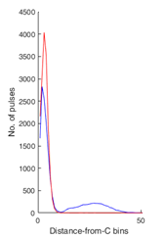
γ-only
D-value histograms of distances from C_{γ} for pulses from the γ-only Reference Set (red) and n+γ pulses (blue)
n+γ
With D-values HDM gives a lower-bound estimate of 27% neutrons in Cf-252.
Summed projection of Q-value histograms for the γ-only Reference Set (red) and n+γ pulses (blue)
With Q-values HDM gives a lower-bound estimate of 30% neutrons in Cf-252.
Both of these estimates are within the 25-30% estimates obtained by other methods.

Slide 25
Small samples
- To test HDM, γ-only and n+γ samples originally consisted of 16,000 pulses.
- Does this method work for much smaller sample sizes?

Slide 26
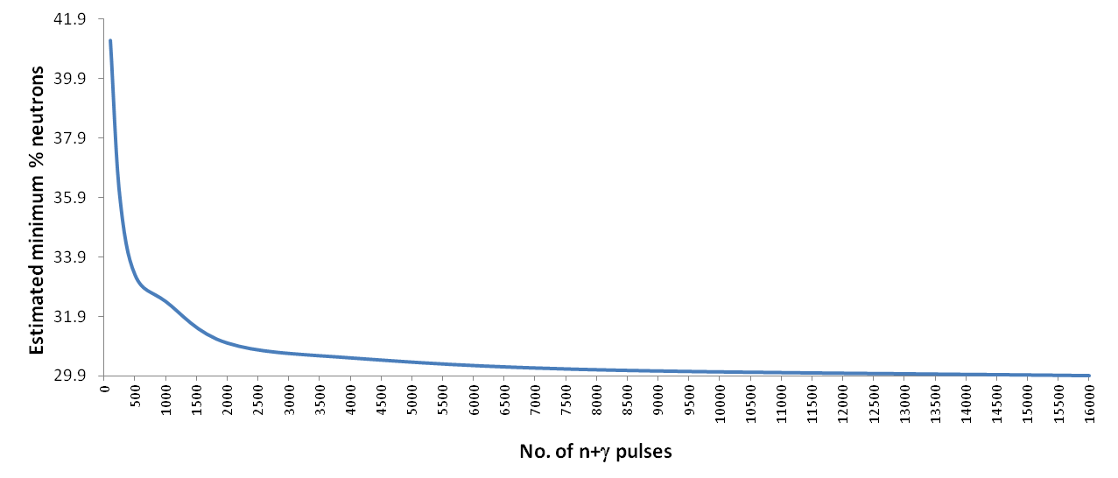
The γ-only Reference Set, S_{γ}, has 16,000 pulses.
We scale it to have the same total number of pulses as S_{n+γ}.
4%
< 1%

Slide 27
Conclusions
HDM is a simple method for calculating whether there is neutron emission from a given source and, if so, determines a lower bound on the percentage of neutron pulses from that source.
HDM’s results correspond to values found using other, more complex methods.
HDM does not depend on a particular pulse representation.
HDM is computationally efficient.
HDM can easily be implemented in hardware (FPGA).

Slide 28





Thank you!

